Slide 1




Business Process Excellence
SteerCo status updated
June-2020
Tech & Ops
1 June,2020

Slide 2


Agenda
01
Project Objectives & Scope
02
Project Team
03
Project Governance
04
BPE Project Progress Dashboard
05
Key Achievements Till Date
06
Tech & Ops Sectors Project Milestones Dashboard
07
What is Next?

Slide 3
Project Background & Objectives
Tech & Ops aims to achieve the following objectives:
Improve and Model Tech & Ops Business processes as per industry best practices
Establish a centralized governance and unified repository for business processes
01
02
Achieve better alignment between business process management and automation teams
03
Support and contribute to the Tech & Ops operational excellence and digital transformation objectives
Support the realization of the process and quality oriented culture within Tech & Ops
04
05

Slide 4
Business Process Excellence – Overall Targets
Tech & Ops aims to achieve the following overall targets by December 2020:
 | Baseline 2019 | Target 2020
Tech&Ops | 42% | 75%
Infrastructure | 61% | 80%
CAD | 37% | 70%
CS | 30% | 70%
Application | 40% | 77%
EA | 30% | 70%
Operations | 42% | 75%
TP | 56% | 80%
2019 OXI Score
42% Established
Domain | 2019 % Score (baseline) | 2020 % Score (target)
Process Maturity (Process) | 44 | 80
Measurement & Controlling (KPIs) | 40 | 75
Automations | 48 | 75
Quality Culture | 28 | 75
Process
2020 OXI Score
75% Mature
75
Culture
75
75
KPIs
0 – 20% | Initial
21 – 40% | Basic
41 – 70% | Established
71 – 90% | Mature
91 – 100% | Excellent
75
Baseline
Weightage Criteria
Target
Automation

Slide 5


Business Process Excellence – Overall Targets
Sample Benefits of BPE for Tech & Ops Sectors
Faster process change and adoption through adequate process governance collaboration capabilities.
1
Process Change Governance
Improve the skills of the staff to perform their activities reducing errors, promoting SMEs as Quality Champions in their domains.
4
2
Training and Knowledge Transfer
Common Target
to Achieve
Tech & Ops OXI 75%
by Dec 2020
Improve customer experience for Tech & Ops internal and external customers, contributing to strategic STC objectives.
3
Customer Experience
3
2
Streamlined and consolidated process model across Tech & Ops, thus supporting faster time-to-value for Tech & Ops services.
4
Cross-functional process alignment and harmonization
Enhanced overall automation mechanism through better alignment between Business Process Management and Automation teams.
1
5
Automation

Slide 6







Project Team
STC Program Sponsor
Abdullah M. Alowini
Haytham A. Alshehry
Program Sponsor
Ayman Qammaz
Khalid Abdelaal
STC Program Director
Mohammed A. Alroeis
Program Director
Bilal Moussa
Abdulaziz Ghboun
STC Quality Control
Dawi M. Alshalawi
STC Program Manager
Abdulaziz Almuaiquel
Program Change Mgmt.
Pascal Soltysiak
Program Manager
Jose Oliveros
Back Office Support
Cross-Integration
BPM –
Operations
BPM – Infrastructure / EA
BPM –
Apps / Analytics / CyberSecurity
Operational Excellence
Tools & Reporting
SMEs
Cross-Integration Leader
STC Track Leader
Shaman Alanazi
STC Track Leader
Abdulaziz AlMuaiqel
STC Track Leader
Rayan Khuris
Senior Consultant
Track Leader
BPM Tool
(SAG ARIS) Consultant
Telecom SME
Senior BPM Consultant
Track Leader
Senior BPM Consultant
Track Leader
Analytics Tool (TABLEAU)
Consultant
GDs SMEs
Senior BPM Consultant
Track Leader
BPM Consultants
BPM Consultants
BPM Consultants
LEGEND
BPM Consultant
BPM Consultant
BPM Consultant
GDs Process Owners
GDs Process Owners
GDs Process Owners

Slide 7
Project Governance
Review Board
SVP / VPs
Quarter
Strategic Alignment
Progress
Issues / Risks
VPs to attend first three Steering Board meetings.
Next Steering Board will take place on Jun 21st.
Steering Board
VPs / GMs
Monthly
Strategic Decisions
Approved Changes
Progress
Issues / Risks
Change Request
Recommendation
Awareness & training
Ownership & Responsibility
Motivation & Recognition
Workgroups
Progress
Issues / Risks
Weekly
Change Management Team
Decisions
Approved Changes
Change Request
Recommendation
Project Management Team
Change Board
Change Request
Assignments
Deliverables Approval
Decisions
Approved Changes
Progress
Issues / Risks
Project Team
GDs SMEs and process owners are members of the Project Team and the Change Management Team.

Slide 8
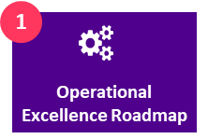
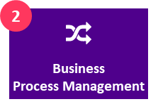

Project Scope Description
The scope is composed of two parallel tracks:
Operational Excellence Maturity Model Dimensions
Process Governance and & Management
Performance Management
(SLAs, KPIs)
Systems and Tools and Reporting
People Capabilities and Culture
Audit and Control Methods
0 1
Business process governance and management practice
Business Process Excellence
0 2
Business Process Modeling and Improvement
0 3
Business Process Management Tooling(*)
Technology &
Operations
Data
Implementation of a holistic business process excellence practice
0 4
Business Process Performance Management and Monitoring (Metrics Dashboarding & Reporting)
Operational Excellence Roadmap
……………
Business Process Management
…..

Slide 9
Operational Excellence
Start Date: 09/03/2019
Finish Date: 29/04/2021
Program Benefits
Program Information
Key Accomplishments
RAQAMI-L
Accomplish higher level of Tech & Ops maturity and align various projects that include Operation Excellence scopes.
Program Beneficiary: Tech & Ops
Program Vendors: Solution, Devoteam
Program Manager: Mohammed A. Alroeis
OX Maturity Framework completed. Deliverables submitted for approval.
BPM Framework and Governance deliverables submitted for approval.
On-going analysis of information provided by SMEs from all GDs.
On-going configuration of ARIS (testing environment).
Achieve Efficiency Increase/ Revolutionize culture towards Agility
AE5: Business Process Excellence
RA2: Building New Way of Work with Agile
Planned
16%
2020
Target
70%
Program Deliverables
Targets / KPIs - 2020
2020
Target
60%
Actual
7%
Accomplish higher level of Tech & Ops maturity and align various projects that include Operation Excellence scopes. 22 Assessment reports.
Departmental Functional Alignment.
Maturity Level and Process improvement and excellence
Sprints timelines might be adjusted to align with process prioritization.
Planned
7%
Actual
16%
PROGRAM PROGRESS
FINANCIAL PROGRESS
Projects | Status | Wtg (%) | Actual / Plan (%) - YTD | Current Milestones | 2020 (70% Target Achievement)
 |  |  |  |  | Jan | Feb | Mar | Apr | May | Jun | Jul | Aug | Sep | Oct | Nov | Dec
Business Process Excellence |  | 4% | 100/100 | Initiation & Planning
 |  | 9% | 53/53 | Operational Excellence Roadmap
 |  | 87% | 9/9 | Business Process Management
Project Management Plan
Envisioning & Preparation
Measurement & Reporting
Analysis &
Roadmap
Measurement & Reporting
Sprint 1
Sprint 2
Sprint 3
62%
BP Management Practice Setup
Business Processes Performance
Issues | Severity | Impact | Suggestion/Solution | Management Support
Risks | Severity | Impact | Suggestion/Solution | Management Support
New STC Policy against current Virus situation (accessibility & meeting ) | Moderate |  | Continue leveraging digital communication channels and remote access to required STC resources (e.g., ARIS, process documentation repositories, etc.).
Dependency between Operational Excellence Project and other Tech & Ops Project (Lean, Inspiration, DTO, ..etc.) | Moderate |  | On-going identification of relevant initiatives (on-going and planned) to direct other projects heads to keep full alignment and communication between projects especially incase the other project involve developing and updating processes.
Frequent Organizational / Structural & mandate changes. | High |  | The project team shall be informed for any prior organizational / structural changes that need to update / modify the technology and operations processes. To involve (or at least consult) the program manager for any potential changes on the technology and operations restructuring activities.
Legend
Project Status
Timeline
Milestones
Risks/Issues
M
Planned
In Progress
Minor (2% < 5%) Delay
Major (> 5%) Delay
Baseline Plan
Revised Plan
Actual
Forecast
Planned
Completed
Minor Delay
Delayed
Low
Moderate
High
Multi-year program, planned to conclude beyond 2020

Slide 10
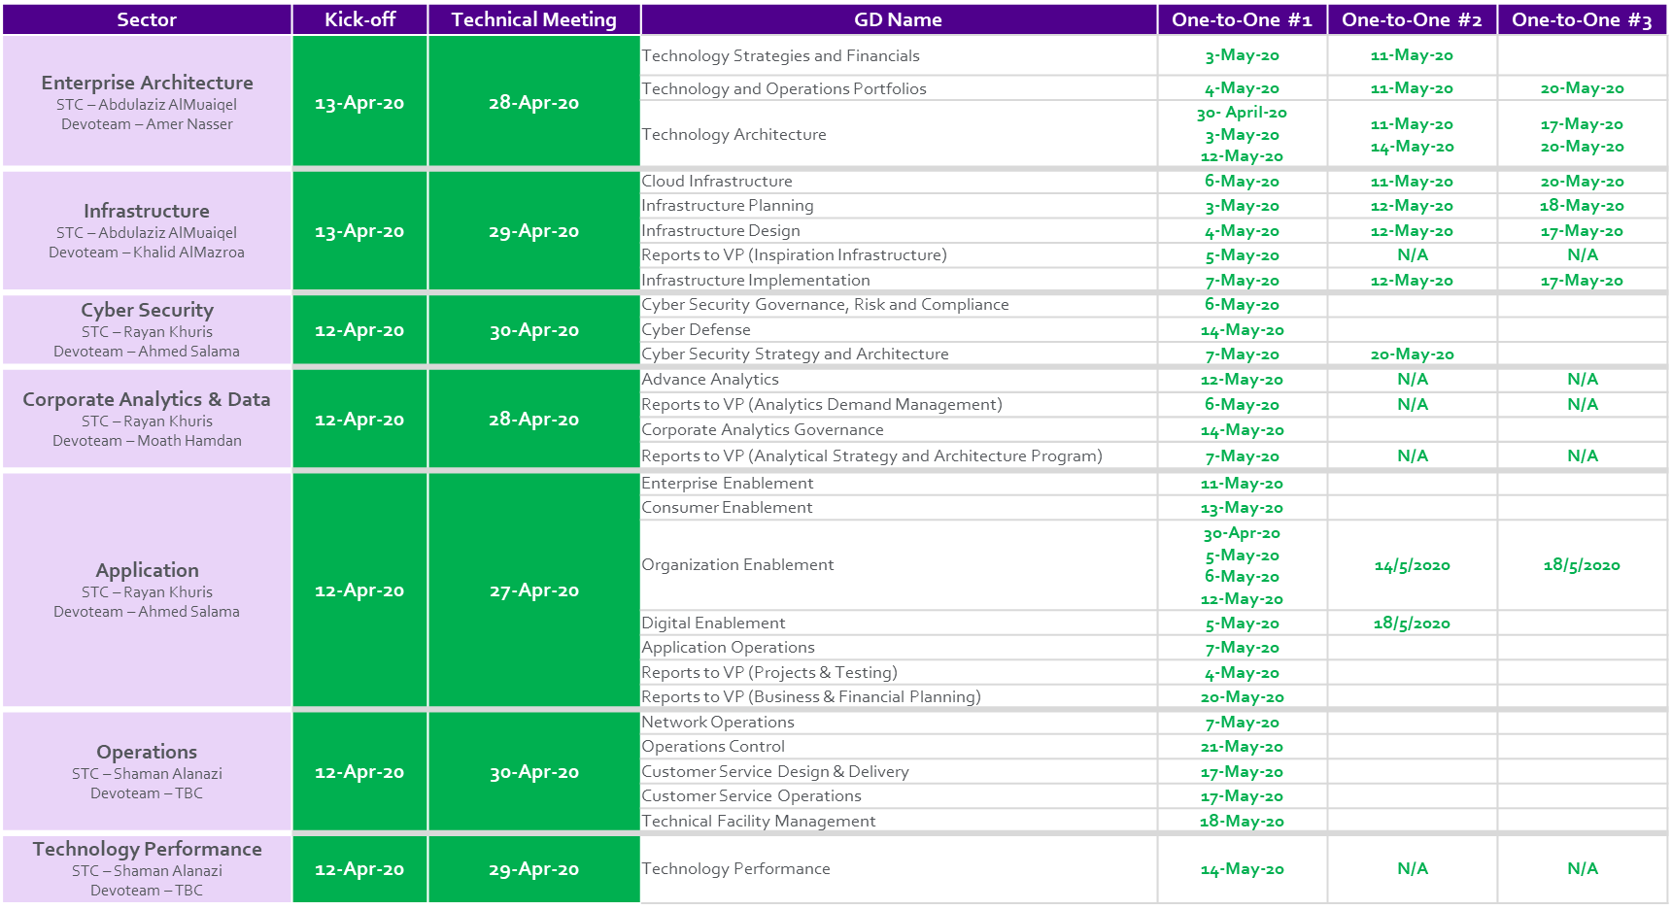

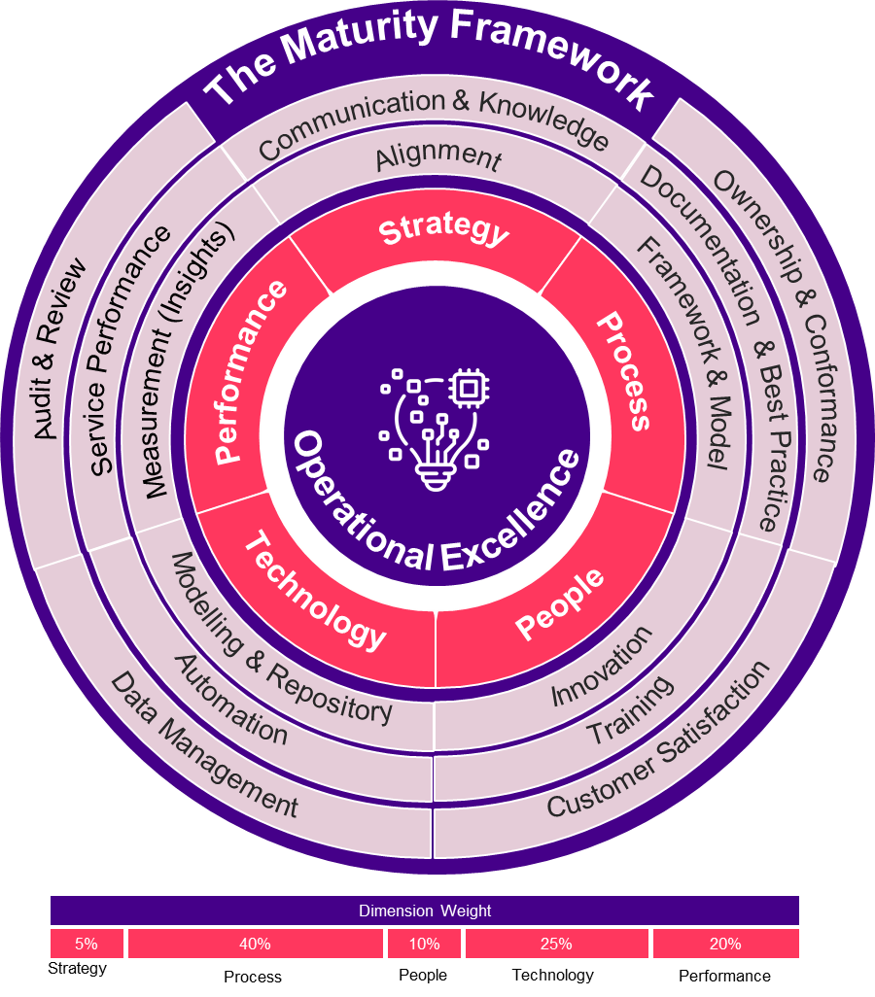
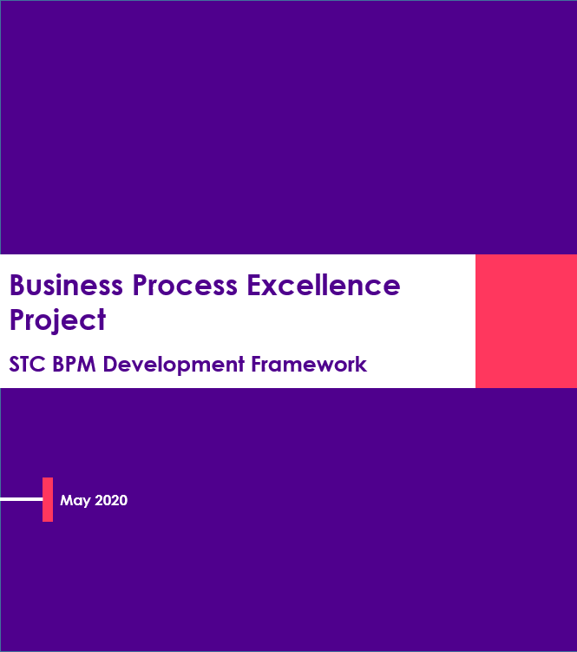
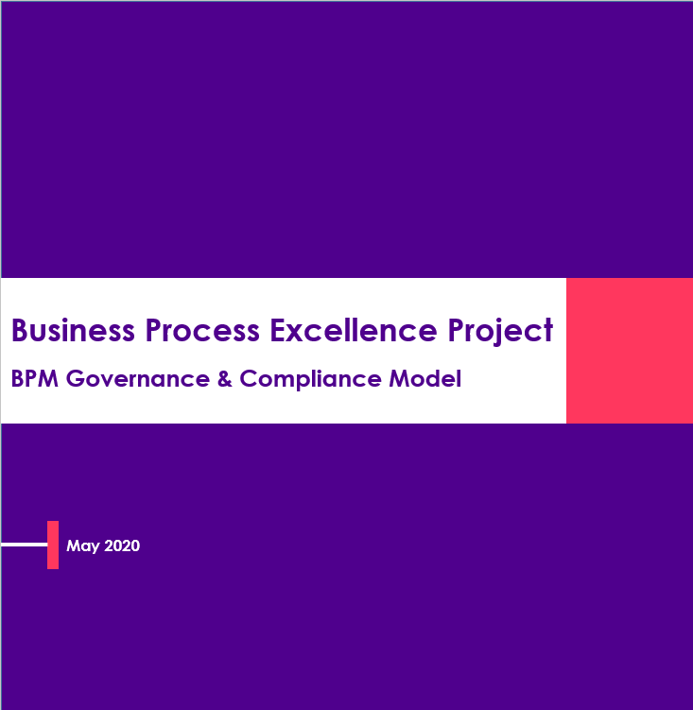
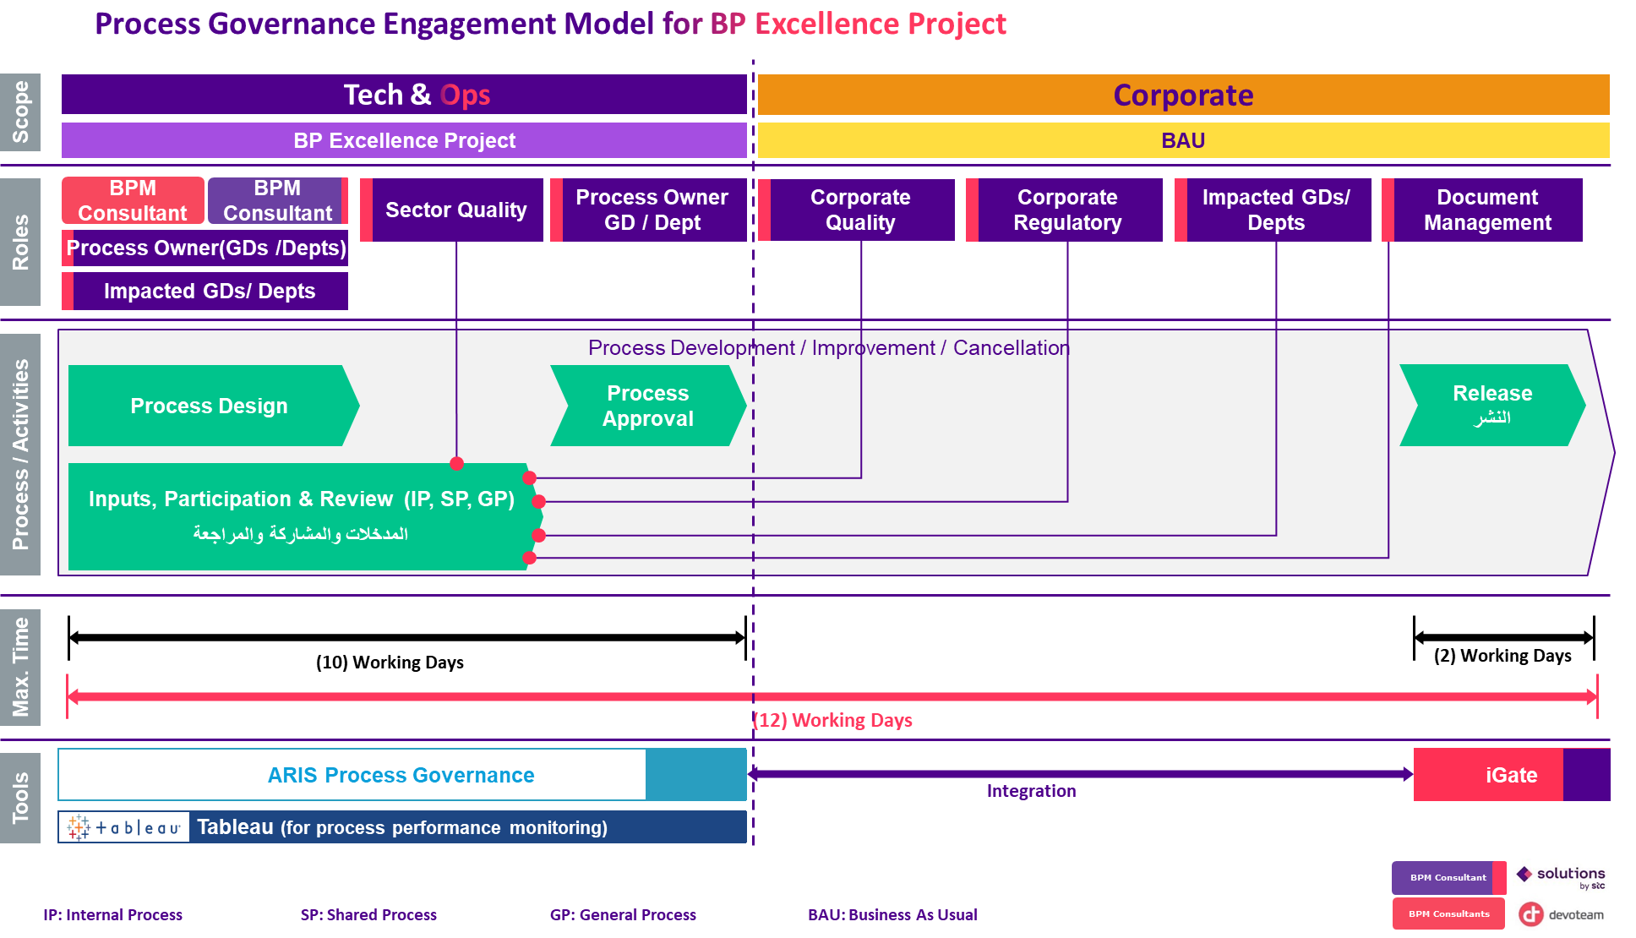
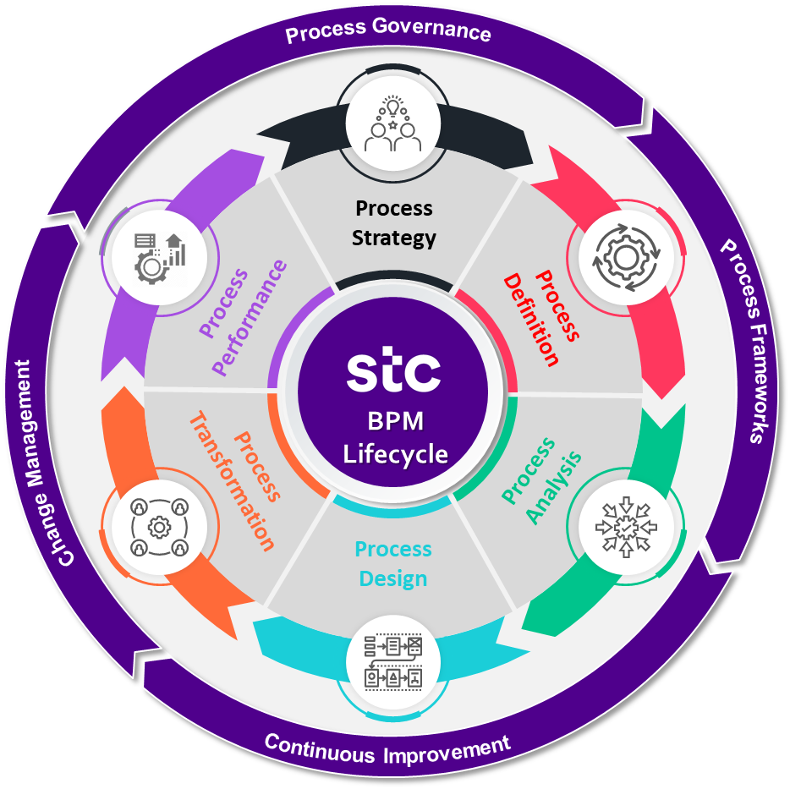
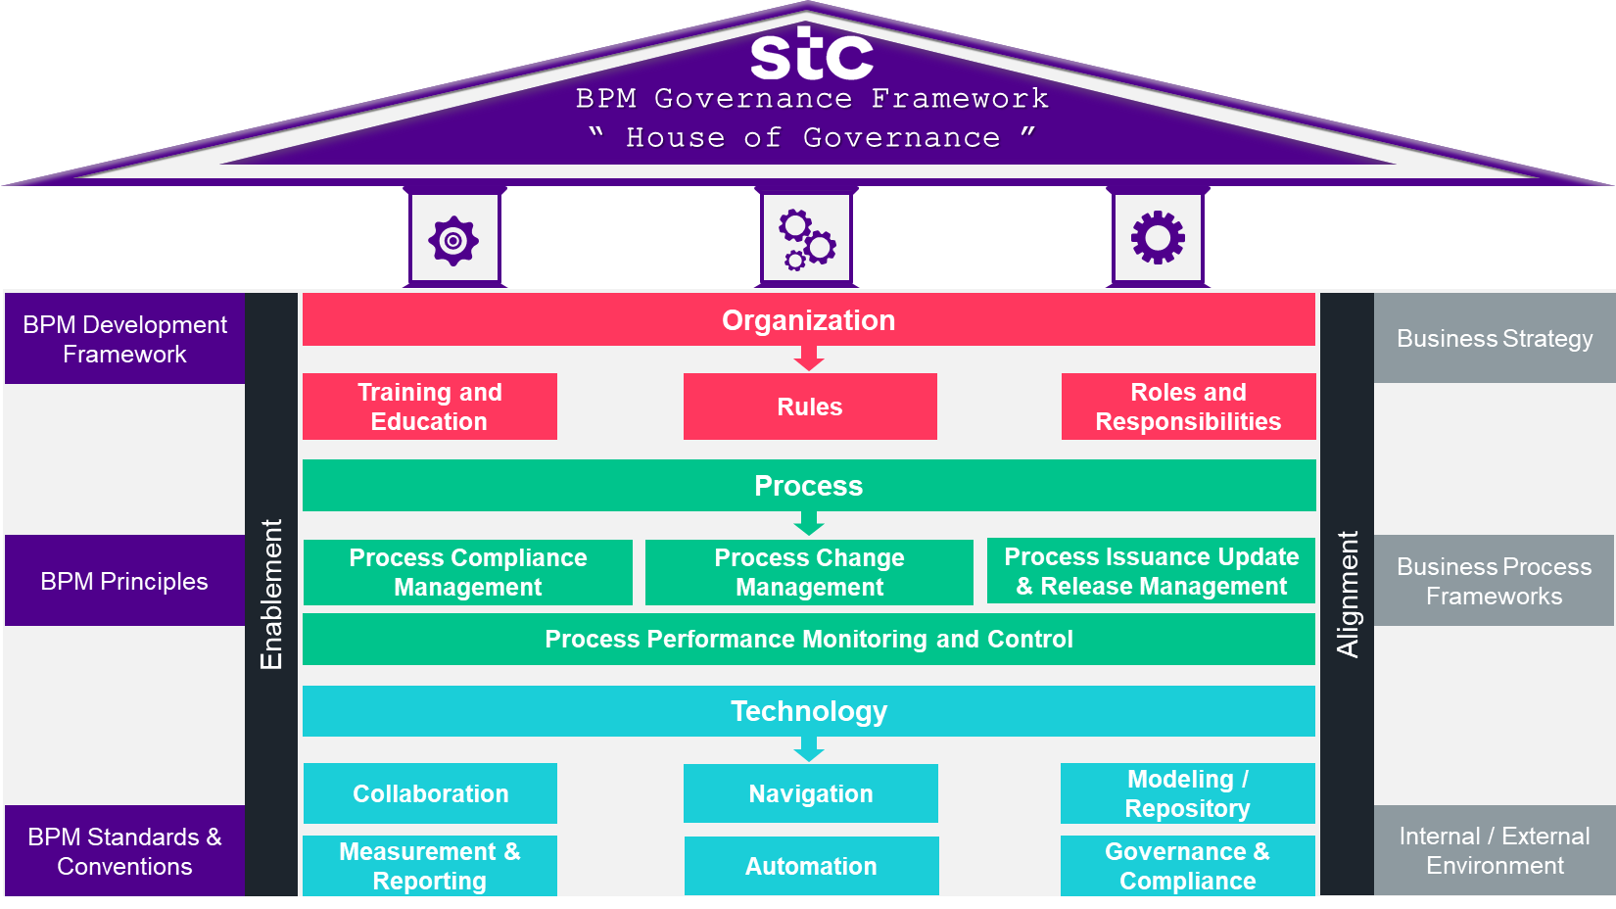
Key Achievements Till Date
Initiation & Planning
Operational Excellence Roadmap
1
Kick off & Technical meeting
2
Operational Excellence Maturity Framework
Business Process Management
3
Business Process Management Development Framework
4
Business Process Governance and Compliance Model

Slide 11
GDs SMEs Meetings
Sector | Kick-off | Technical Meeting | GD Name | One-to-One #1 | One-to-One #2 | One-to-One #3 | OXM Kick-off | OXM One-to-One
Enterprise Architecture STC – Abdulaziz AlMuaiqel Devoteam – Amer Nasser | 13-Apr-20 | 28-Apr-20 | Technology Strategies and Financials | 3-May-20 | 11-May-20 |  | 15-Jun-20 | 16-Jun-20
 |  |  | Technology and Operations Portfolios | 4-May-20 | 11-May-20 | 20-May-20 |  | 16-Jun-20
 |  |  | Technology Architecture | 30- April-20 3-May-20 12-May-20 | 11-May-20 14-May-20 | 17-May-20 20-May-20 |  | 18-Jun-20
Infrastructure STC – Abdulaziz AlMuaiqel Devoteam – Khalid AlMazroa | 13-Apr-20 | 29-Apr-20 | Cloud Infrastructure | 6-May-20 | 11-May-20 | 20-May-20 | 15-Jun-20 | 18-Jun-20
 |  |  | Infrastructure Planning | 3-May-20 | 12-May-20 | 18-May-20 |  | 17-Jun-20
 |  |  | Infrastructure Design | 4-May-20 | 12-May-20 | 17-May-20 |  | 18-Jun-20
 |  |  | Reports to VP (Inspiration Infrastructure) | 5-May-20 | N/A | N/A
 |  |  | Infrastructure Implementation | 7-May-20 | 12-May-20 | 17-May-20 16-Jun-20
Cyber Security STC – Rayan Khuris Devoteam – Ahmed Salama | 12-Apr-20 | 30-Apr-20 | Cyber Security Governance, Risk and Compliance | 6-May-20 |  |  | 14-Jun-20 | 16-Jun-20
 |  |  | Cyber Defense | 14-May-20
 |  |  | Cyber Security Strategy and Architecture | 7-May-20 | 20-May-20
Corporate Analytics & Data STC – Rayan Khuris Devoteam – Moath Hamdan | 12-Apr-20 | 28-Apr-20 | Advance Analytics | 12-May-20 | N/A | N/A | 15-Jun-20 | 18-Jun-20
 |  |  | Reports to VP (Analytics Demand Management) | 6-May-20 | N/A | N/A |  | 18-Jun-20
 |  |  | Corporate Analytics Governance | 14-May-20 |  |  |  | 18-Jun-20
 |  |  | Reports to VP (Analytical Strategy and Architecture Program) | 7-May-20 | N/A | N/A |  | N/A
Application STC – Rayan Khuris Devoteam – Ahmed Salama | 12-Apr-20 | 27-Apr-20 | Enterprise Enablement | 11-May-20 |  |  | 14-Jun-20 | 18-Jun-20
 |  |  | Consumer Enablement | 13-May-20 |  |  |  | 17-Jun-20
 |  |  | Organization Enablement | 30-Apr-20 5-May-20 6-May-20 12-May-20 | 14-May-20 | 18-May-20
 |  |  | Digital Enablement | 5-May-20 | 18-May-20 |  |  | 17-Jun-20
 |  |  | Application Operations | 7-May-20 |  |  |  | 16-Jun-20
 |  |  | Reports to VP (Projects & Testing) | 4-May-20
 |  |  | Reports to VP (Business & Financial Planning) | 20-May-20
Operations STC – Shaman Alanazi Devoteam – TBC | 12-Apr-20 | 30-Apr-20 | Network Operations | 7-May-20 |  |  | 15-Jun-20
 |  |  | Operations Control | 21-May-20
 |  |  | Customer Service Design & Delivery | 17-May-20
 |  |  | Customer Service Operations | 17-May-20
 |  |  | Technical Facility Management | 18-May-20
Technology Performance STC – Shaman Alanazi Devoteam – TBC | 12-Apr-20 | 29-Apr-20 | Technology Performance | 14-May-20 | N/A | N/A | 15-Jun-20

Slide 12
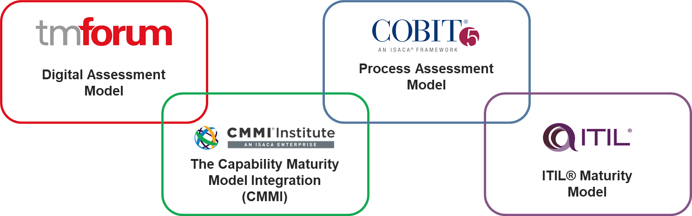
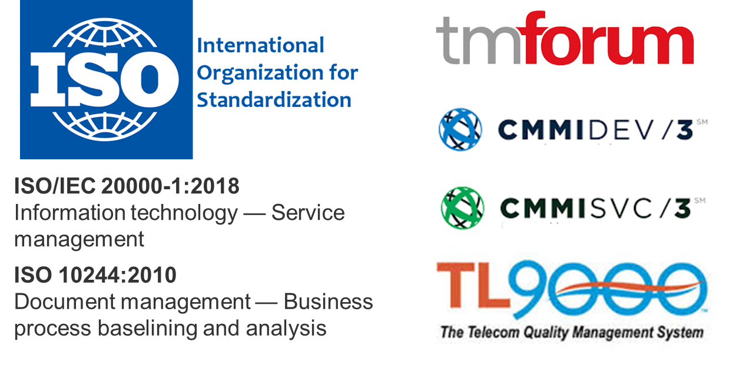
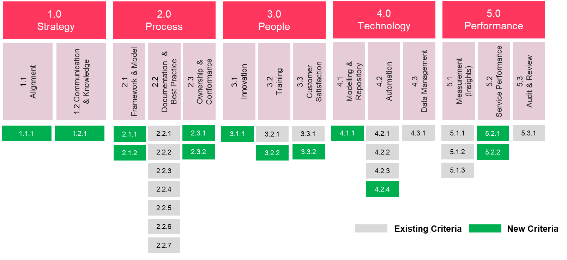
2. Operational Excellence Maturity Model
Reference Frameworks and Industry Best Practices
Ongoing consideration for target certifications

Slide 13
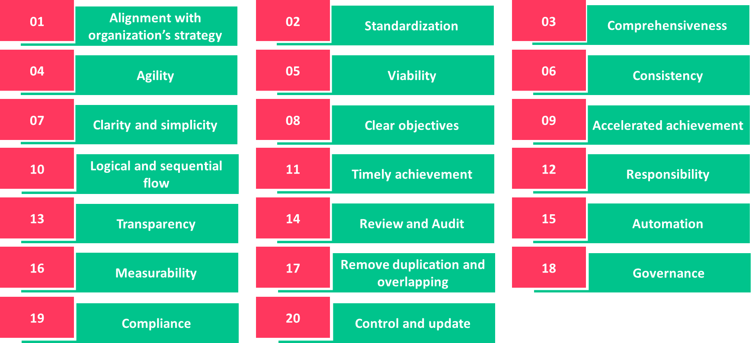
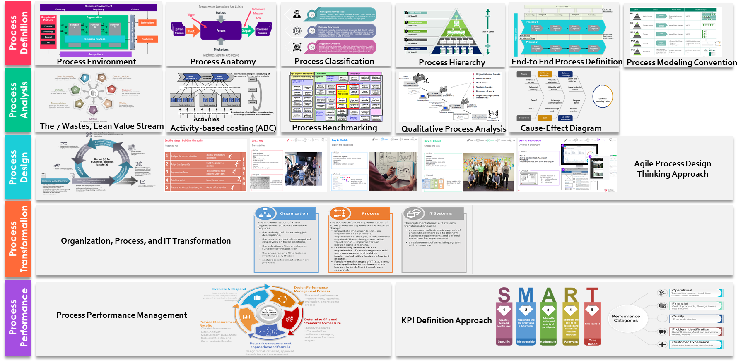

3. Business Process Management Framework
Process Definition, Analysis & Design Principles
BPM Guidelines, Tools and Techniques

Slide 14
4. Business Process Governance – Model
(*) Tableau has been initially identified as process performance reporting platform, but a final decision will be made by STC.
(*) Integration of ARIS and iGATE is currently under discussion with relevant stakeholders.

Slide 15
4. Business Process Governance – Framework

Slide 16
Sectors Project Milestones Dashboard
Infrastructure
Enterprise Architecture
Operations
Planned
11%
Infr. Planning
Planned
11%
Tech. & Ops. Portfolio
Planned
11%
Network Operations
Infr. Design
Tech. Strategies & Fin.
Operations Control
Actual
11%
Infr. Implementation
Actual
11%
Tech. Architecture
Actual
10%
Cus. Ser. Design & Deliv.
Cloud Infrastructure
Cus. Ser. Operations
Tech. Facilities Mgmt.
Cyber Security
Corporate Analytics & Data
Planned
11%
Application
Consumer Enablement
Planned
11%
Cyber Defence
Planned
11%
Advanced Analytics
Enterprise Enablement
Gov., Risk & Compliance
Demand Management
Actual
11%
Digital Enablement
Actual
11%
Strategy & Architecture
Actual
10%
Analytics Governance
Application Operations
Strategy and Architecture
Org. Enablement
Projects & Testing
Bus & Financial Planning
Technology Performance
Planned
11%
Actual
11%
In Progress
<+2%
Minor Delay
>2% <=5%
Major Delay
> 5%

Slide 17

Next Steps & Required Support
Next Steps
Finalize the GD’s Mandates and update HR with final R&R to avoid changes and utilize the exercise efficiently as it will be built in ARIS and fixed.
Empower the SMEs with the Authority to:
Represent the GM and continue to be delegated by him for any demand or approvals needed.
Complete each GD’s project milestone within the specified timeline
Share project information with the project team
Actively participate in process design sprints (process design, reviews, comments, approvals).
Promote and support the Change Management activities, actively promoting the attendance/participation of staff in all change management activities along the program execution.
Reflecting any changes ongoing or planned related to the processes and consider it as part of the information that should be shared and reviewed mutually.
Finalize information gathering from all Sectors.
GDs Information analysis and Sprints design (aligned with SMEs).
ARIS configuration (support from IT and CQM).
OXI measurement.
Sprints execution begins by 1st of July.
Required Support

Slide 18
Thank you

